Slide 1
Graph Neural Networks lecture-7 Course on Graph Neural Networks (Winter Term 20/21)
Prof. Dr. Holger Giese (holger.giese@hpi.de)
Christian Medeiros Adriano (christian.adriano@hpi.de) - “Chris”
Sona Ghahremani (sona.ghahremani@hpi.de )

Slide 2
Quick recap
Metrics
Classification
Random Walk
Node Embedding
Why do we need Graph Neural Networks?

Slide 3
Topics
Softmax
GraphSage
Graph Convolution Networks

Slide 4
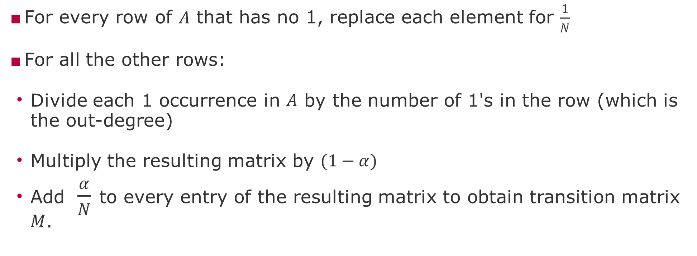
Derivation of Transition matrix $M$ from Adjacency matrix $A$
For every row of $A$ that has no 1, replace each element for $\frac{1}{N}$
For all the other rows:
Divide each 1 occurrence in $A$ by the number of 1's in the row (which is the out-degree)
Multiply the resulting matrix by $(1−α)$
Add $\frac{α}{N}$ to every entry of the resulting matrix to obtain transition matrix $M$.

Slide 5
Next and Future Tasks
Compute and compare graph metrics (Wednesday, 2.12)
Any metrics and networks of your choice
First draft of abstract (Friday, 4.12)
Predictions using traditional method (Wednesday, 9.12)
Any two methods of your choice
Related work draft (Friday, 11.12)
Node and Graph Feature Learning (Wednesday, 16.12)
Any two methods of your choice

Slide 6
END

